Slide 1


Oracle database
Lecture 38

Slide 2

Today’s Agenda
Conditions In PL-SQL
Varieties Of If
Varieties Of Case
Programs

Slide 3
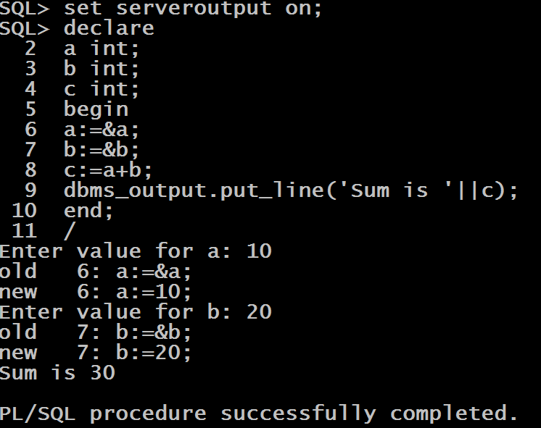
A Program To Add 2 Nos

Slide 4
PL-SQL Conditions
PL-SQL provides the following types of decision making statements.
IF-THEN
IF-THEN-ELSE
IF-THEN-ELSIF
NESTED-IF
CASE
SEARCHED CASE

Slide 5
The IF-THEN Statement
The IF statement associates a condition with a sequence of statements enclosed by the keywords THEN and END IF.
Syntax:
IF condition THEN
Stmts;
END IF;
IF the condition is true, the statements get executed and if the condition is false or NULL then the IF statement does nothing.

Slide 6
The IF-THEN-ELSE Statement
A sequence of IF-THEN statements can be followed by an optional sequence of ELSE statements, which execute when the condition is FALSE.
Syntax:
IF condition THEN
Stmts;
ELSE
Stmts;
END IF;

Slide 7
The IF-THEN-ELSIF Statement
The IF-THEN-ELSIF statement allows us to choose between several alternatives.
Syntax:
IF condition THEN
Stmts;
ELSIF condition THEN
Stmts;
ELSE
Stmts;
END IF;

Slide 8
The NESTED IF Statement
PL/SQL allows us to nest the IF-ELSE statements, which means we can use one IF or ELSE IF statement inside another IF or ELSE statement(s).
Syntax:
IF condition THEN
IF condition THEN
Stmts;
ELSE
Stmts;
END IF;
ELSE
Stmts;
END IF;

Slide 9
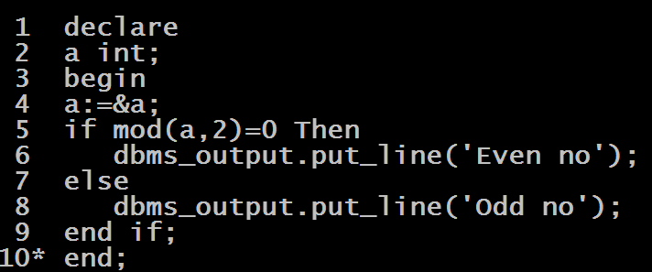
Program
WAP to accept an integer and check whether it is even or odd.

Slide 10
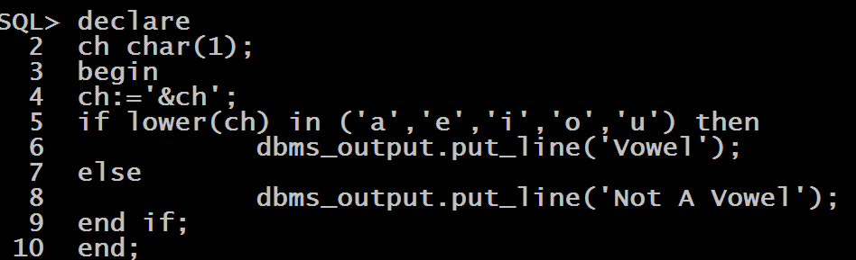
Program
WAP to accept a character and check whether it is a vowel or not

Slide 11
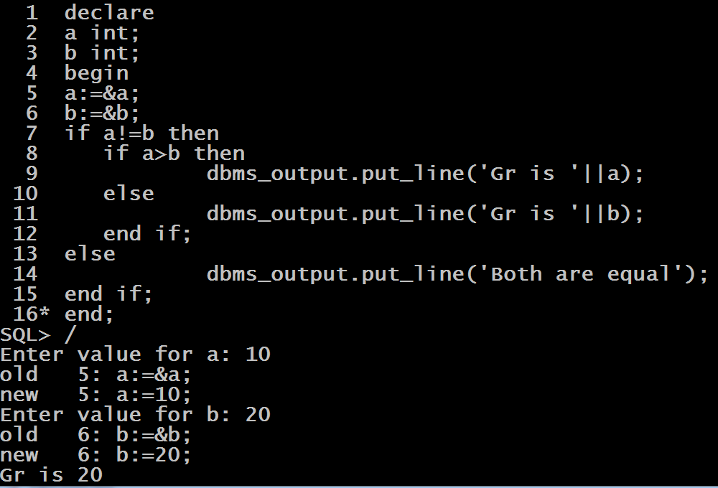
Program
WAP to accept 2 integers and find the greater number amongst them using nested if

Slide 12
The CASE Statement
The CASE statement chooses one sequence of statements to execute out of many possible sequences.
The CASE statement has two types: simple CASE statement and searched CASE statement.
Both types of the CASE statements support an optional ELSE clause.

Slide 13
The CASE Statement
Syntax:
CASE expression
WHEN value THEN
Stmts;
WHEN value THEN
Stmts;
...
ELSE
Stmts;
END CASE;

Slide 14
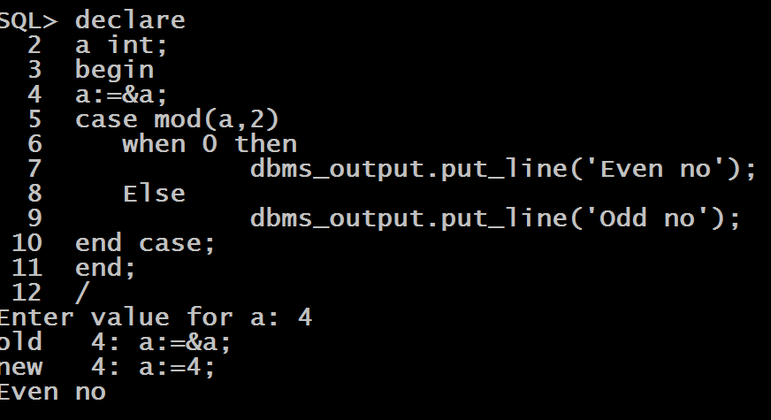
Program
WAP to accept an integer and check whether it is even or odd using Simple CASE statement.

Slide 15
Searched CASE Statement
The searched CASE statement evaluates multiple Boolean expressions and executes the sequence of statements associated with the first condition that evaluates to TRUE.
Syntax:
CASE
WHEN condition THEN
Stmts;
WHEN condition THEN
Stmts;
...
ELSE
Stmts;
END CASE;

Slide 16
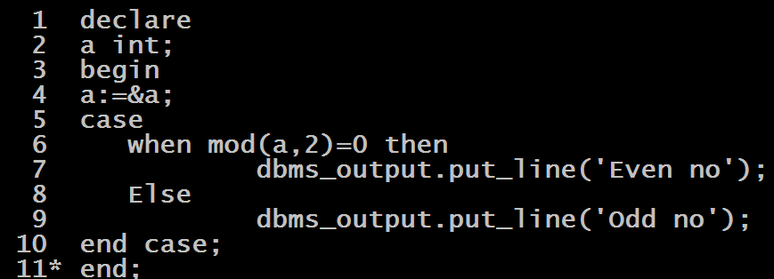
Program
WAP to accept an integer and check whether it is even or odd using Searched CASE statement.

Slide 17
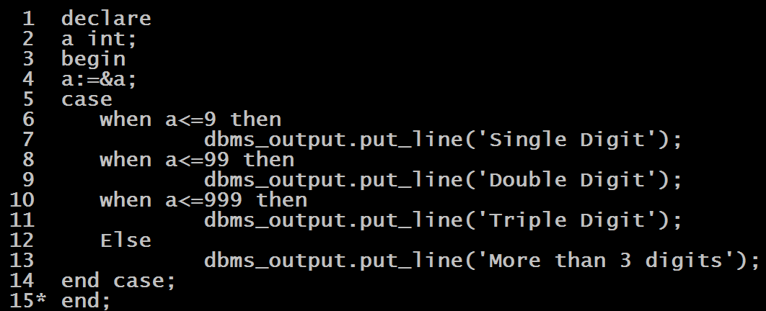
Program
WAP to accept an integer and check whether it is a single digit number or a double digit number or a triple digit number or a number with more than 3 digits

